Slide 1

Introduction to Recurrent Neural Networks
Part 5

Slide 2
Outline
RNN basic
RNN
LSTM, GRU
Applications
Sentiment analysis
Language model
Sequence tagging
Machine translation, conversation model
Reference

Slide 3
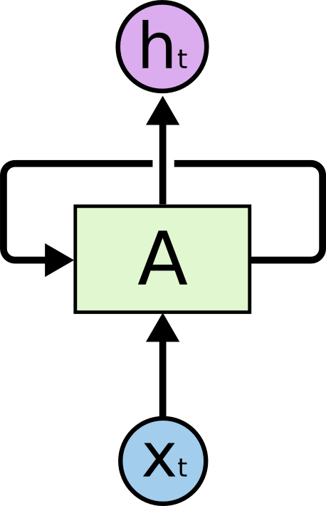
Recurrent Neural Net
Output
Input

Slide 4
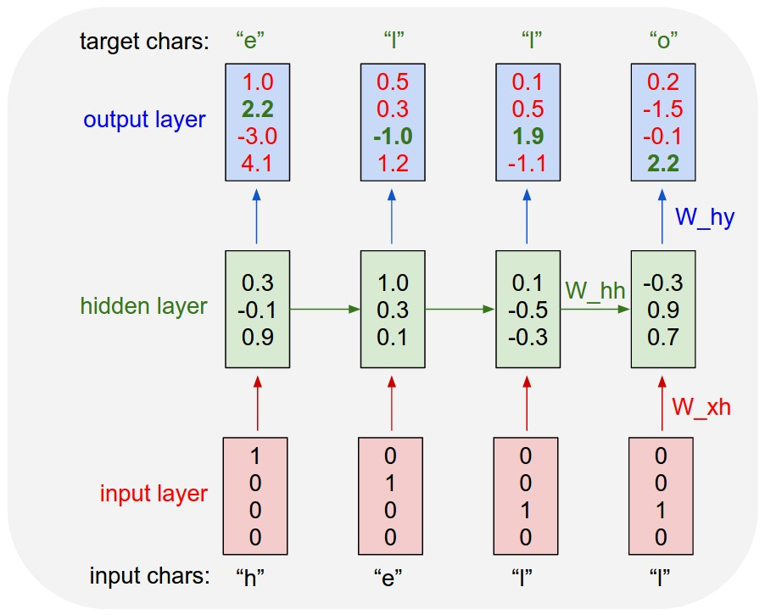
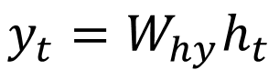
Recurrent Neural Networks
Equation
$$h_{t}=tanh⁡(W_{hh}h_{t−1}+W_{xh}x_{t})$$
$$y_{t}=W_{hy}h_{t}$$
class RNN:
def step(self, x):
self.h = np.tanh(np.dot(self.W_hh, self.h) +
np.dot(self.W_xh, x))
y = np.dot(self.W_hy, self.h)
return y
[Karpathy, Colah]

Slide 5
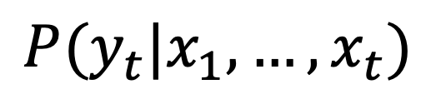
Recurrent Neural Networks
[Karpathy, Colah]
$$P(y_{t}|x_{1},…, x_{t})$$

Slide 6
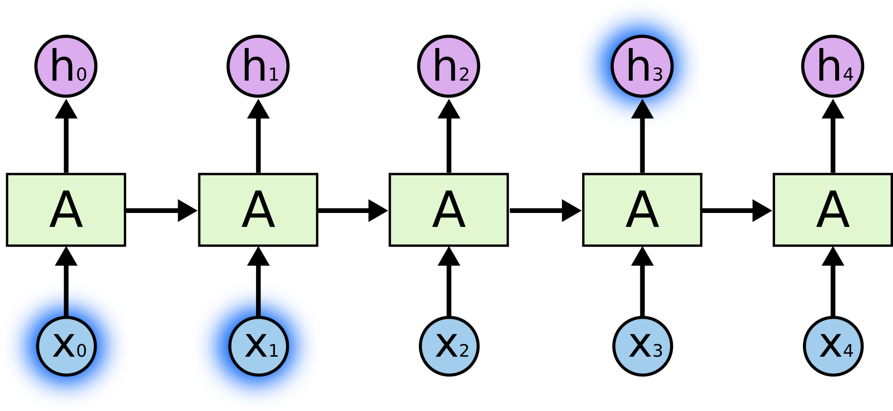
Back-propagation Through Time (BPTT)
Vanishing or exploding gradient problem
E0
E1
E2
E3
E4
[Colah]

Slide 7
Vanishing or exploding gradient problem
Notes:
As the gradients are multiplied over time they are susceptible to exploding (several large >>1 gradients one after the other) or vanishing (several small <<1 multiplied one after the other).
The large ones are relatively easy to solve: they can be clipped.
The vanishing ones are problematic, as they slow the convergence significantly

Slide 8
Long Short Term Memory networks (LSTM)
Gate: Optionally let information through
Cell state: long term memory
Forget gate: determine what old information to forget
Input gate: determine what new information to store
Output gate: decide what to output
https://deeplearning4j.org/lstm.html
From Goodfellow 2017
Notes:
The key is the central plus sign: it helps preserve the error (and its gradient) as it must be back-propagated through the network

Slide 9

LSTM

Slide 10

Cell State – Long-term memory
[Colah]

Slide 11


Forget Gate, Input Gate
Forget Gate - determine what old information to forget
Input Gate - determine what new information to store
[Colah]

Slide 12

Update Cell State based on Input, Forget Gates
[Colah]

Slide 13

Output Gate
[Colah]

Slide 14

Gated Recurrent Unit (GRU)
Merge cell state and hidden state
Combine forget and input gates
[Colah]
Notes:
It is basically an lstm without an output gate, hence it writes the content of its memory ht to the rest of the network

Slide 15
Applications

Slide 16

Sequences with RNNs
Output
Hidden
Input
Image Classification
Sentiment Analysis
[A. Karpathy]
Notes:
http://karpathy.github.io/2015/05/21/rnn-effectiveness/ for image tagging and other demos

Slide 17
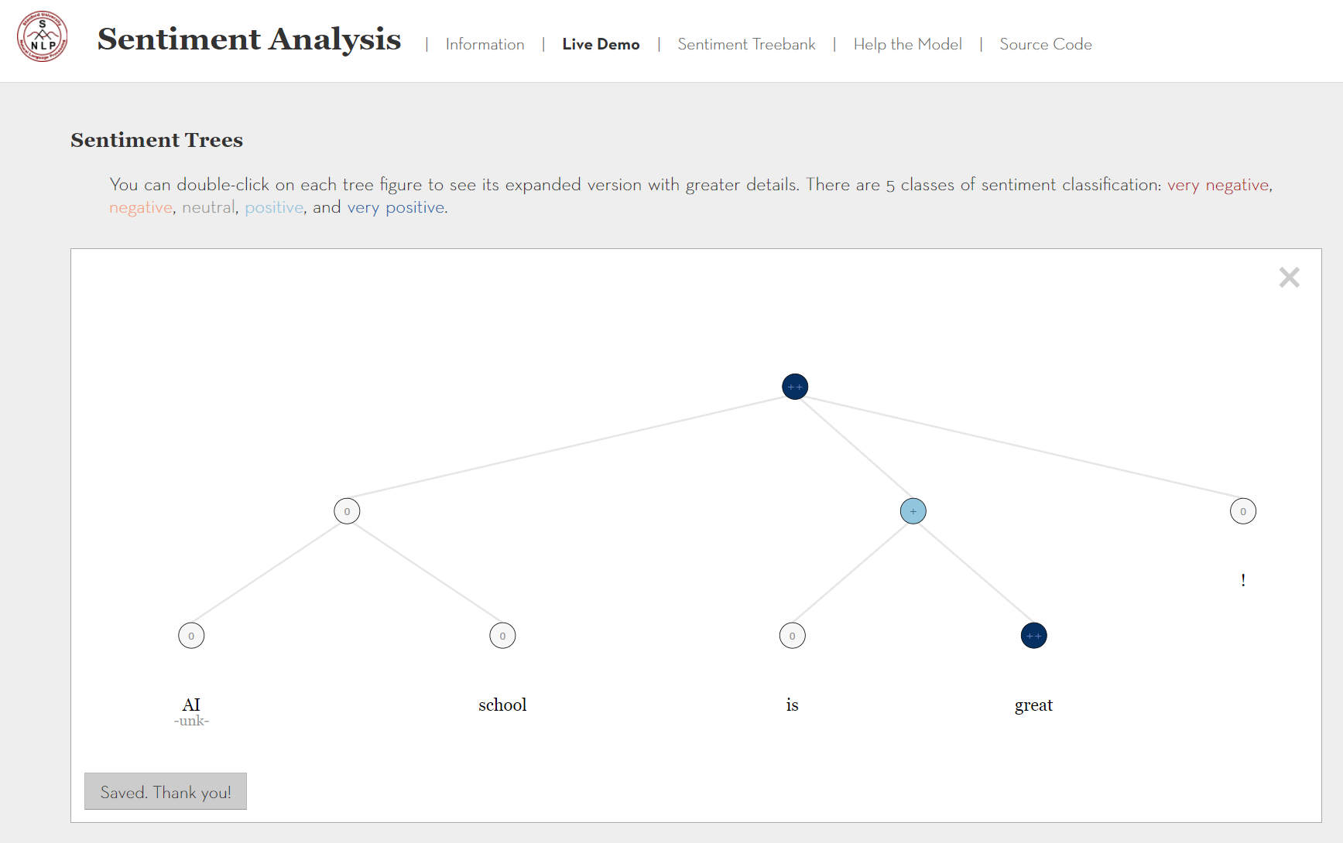
Sentiment Analysis
http://nlp.stanford.edu:8080/sentiment/rntnDemo.html

Slide 18
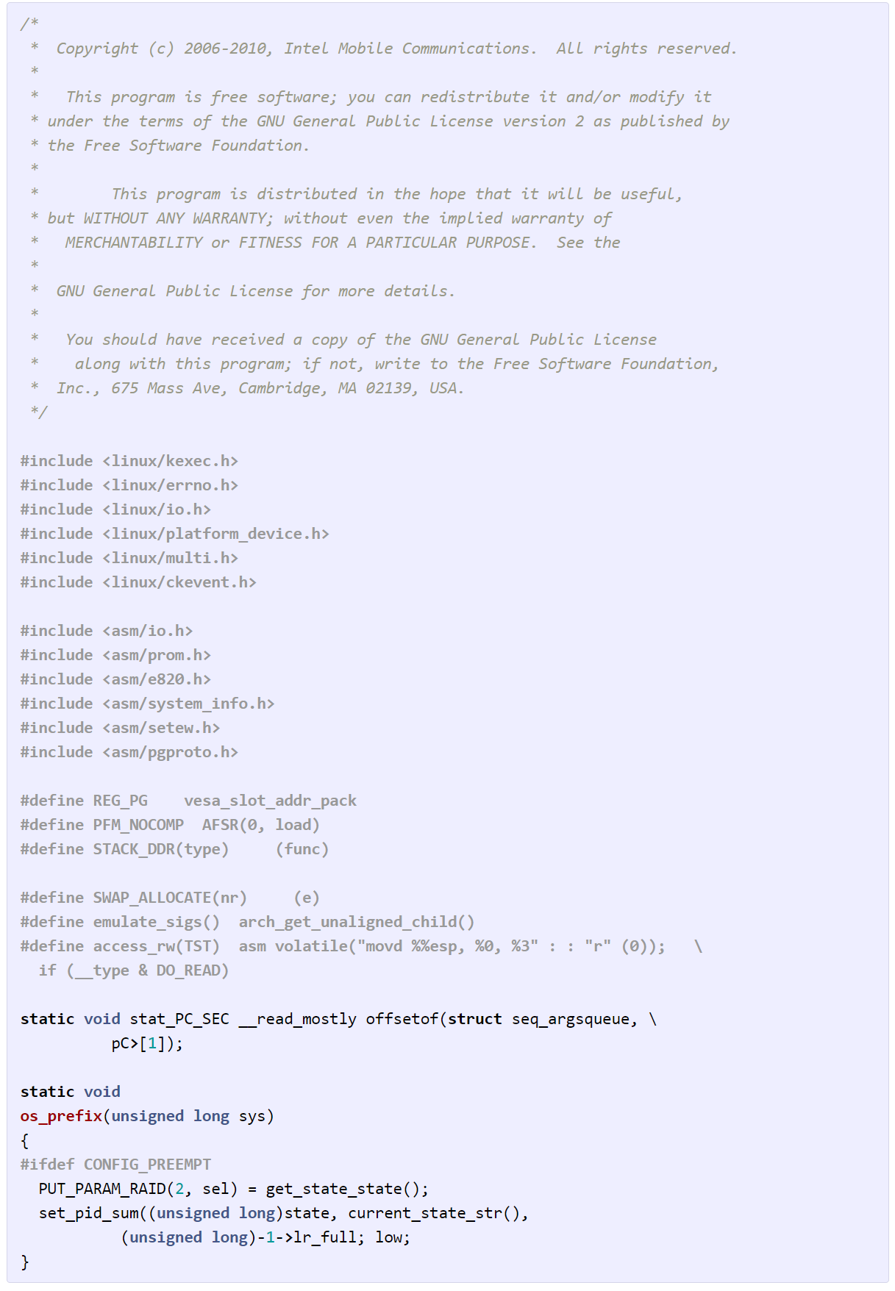
RNN Language Model
[A. Karpathy]

Slide 19
Sequences with RNNs
Output
Hidden
Input
Image Classification
Sentiment Analysis
Sequence Tagging
[A. Karpathy]
Notes:
http://karpathy.github.io/2015/05/21/rnn-effectiveness/

Slide 20
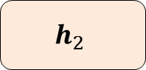
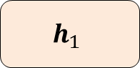
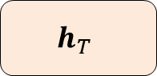
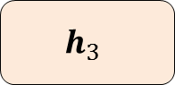
Sequence Tagging
A example in the Airline Travel Information System (ATIS) corpus
 | show | flights | from | boston | to | new | york | today
Slots | O | O | O | B-dept | O | B-arr | I-arr | B-date
O
B-dept
O
B-date
$$h_{1}$$
$$h_{2}$$
$$h_{3}$$
…
$$h_{T}$$
from
Boston
…
today

Slide 21
Sequences to Sequences
Output
Hidden
Input
Image Classification
Sentiment Analysis
Translation
Sequence Tagging
[A. Karpathy]
Notes:
http://karpathy.github.io/2015/05/21/rnn-effectiveness/

Slide 22
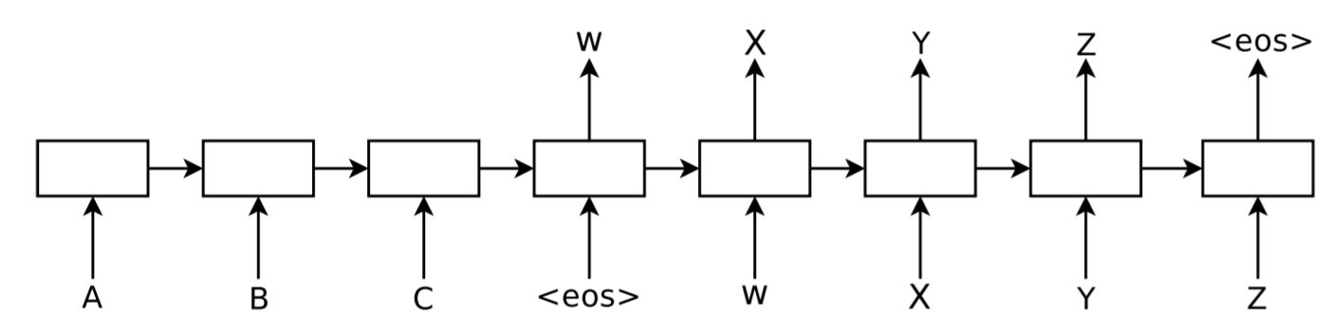
Sequence to Sequence (aka Encoder-Decoder)
Sutskever et al.
Notes:
https://arxiv.org/abs/1409.3215

Slide 23
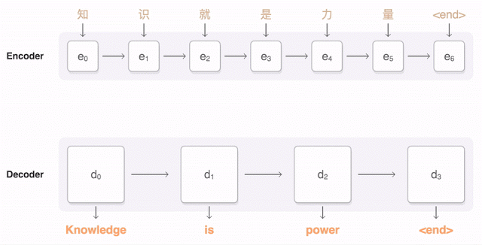
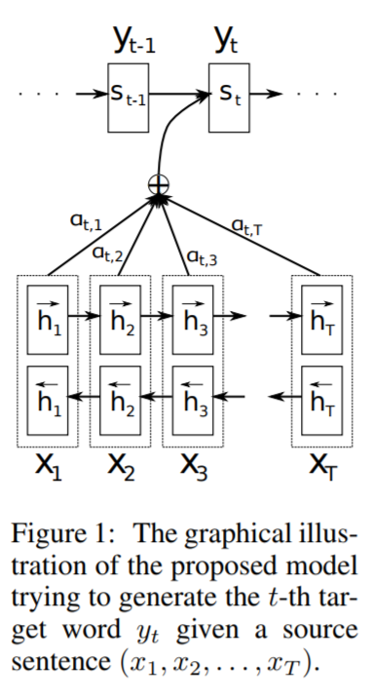
Sequence to Sequence with Attention
[Bahdanau]

Slide 24
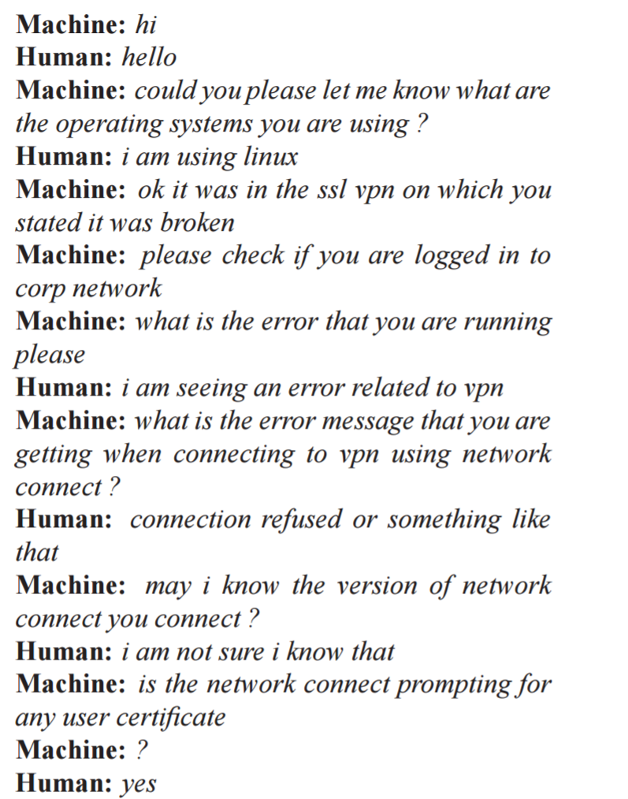
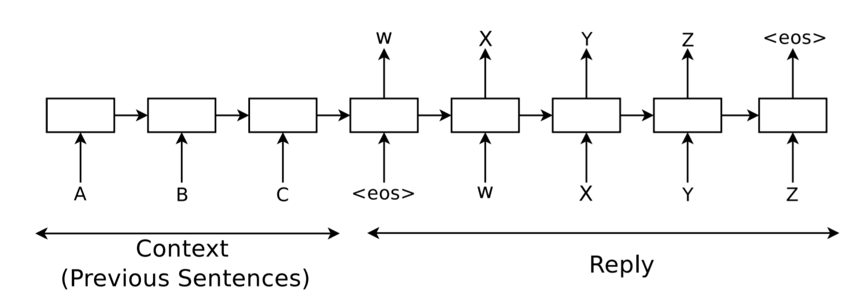
Conversational Model
Notes:
https://arxiv.org/pdf/1506.05869.pdf

Slide 25
Sequences
Output
Hidden
Input
Image Classification
Image Caption
Sentiment Analysis
Translation
Sequence Tagging
[A. Karpathy]
Notes:
http://karpathy.github.io/2015/05/21/rnn-effectiveness/

Slide 26
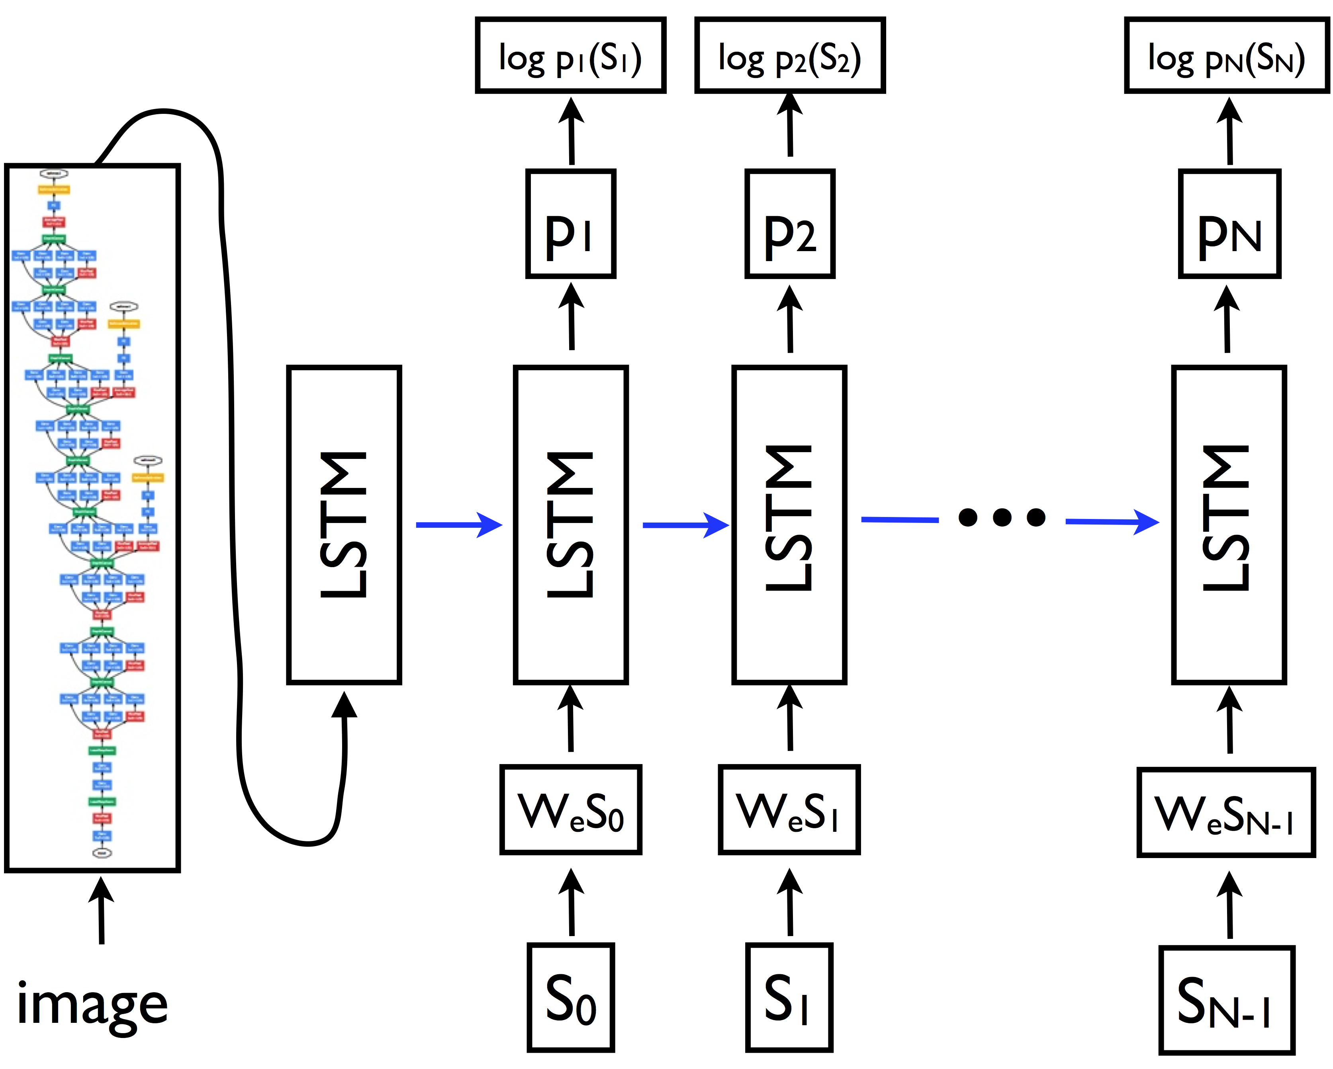
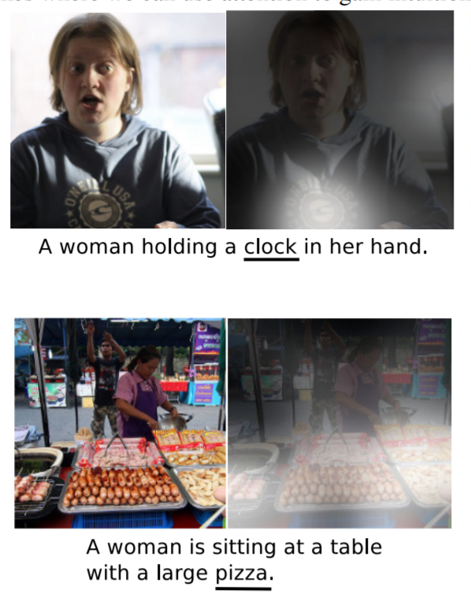
Image Caption
[Vinyals, Xu]
Notes:
https://arxiv.org/abs/1411.4555

Slide 27
Reference
RNN: http://karpathy.github.io/2015/05/21/rnn-effectiveness/
LSTM: http://colah.github.io/posts/2015-08-Understanding-LSTMs/
LSTM: http://deeplearning.cs.cmu.edu/pdfs/Hochreiter97_lstm.pdf
RNN, LSTM: https://www.cs.ox.ac.uk/people/nando.defreitas/machinelearning/lecture11.pdf
GRU: http://arxiv.org/pdf/1406.1078v3.pdf
Sequence to Sequence: https://papers.nips.cc/paper/5346-sequence-to-sequence-learning-with-neural-networks.pdf
Attention: https://arxiv.org/abs/1409.0473

